Slide 1


Blog Management System
by-
1. Wani Pushpak Shrikant
43. Raut Atharva Satish
45. Savant Omkar Vitthal

Slide 2
Introduction
Software
Software Engineering
Blog

Slide 3

1. Software
Software, instructions that tell a computer what to do.
Software comprises the entire set of programs, procedures, and routines associated with the operation of a computer system.

Slide 4

2. Software Engineering
Software engineering is a branch of computer science which includes the development and building of computer systems software and applications software.
Applications software consists of user-focused programs that include web browsers, database programs, etc.

Slide 5

3. Blog
A blog is a discussion or informational website published on the World Wide Web consisting of discrete, often informal diary-style text entries (posts).

Slide 6


History
Software
Software Engineering
Blog

Slide 7

Software
Alan Turing is credited with being the first person to come up with a theory for software in 1935.
Which led to the two academic fields of computer science and software engineering.

Slide 8

Software Engineering
Margaret H. Hamilton was the person who came up with the idea of naming the discipline, software engineering, as a way of giving it legitimacy.
She was a scientist at NASA.

Slide 9


Blog
The term "weblog" was coined by Jorn Barger on December 17, 1997.
The short form, "blog", was coined by Peter Merholz in 1999.

Slide 10
Hardware Requirements
CPU- Pentium Gold or Higher
Storage – 50 mb or Higher
Ram – 2GB Or More
Resolution – 1280 x 720 or Higher

Slide 11
Software Requirements
Windows XP or Higher
Visual Studio 2017 or Higher
.NET Framework 4.5 or Higher

Slide 12
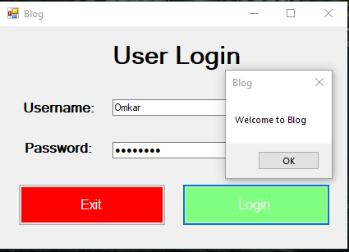
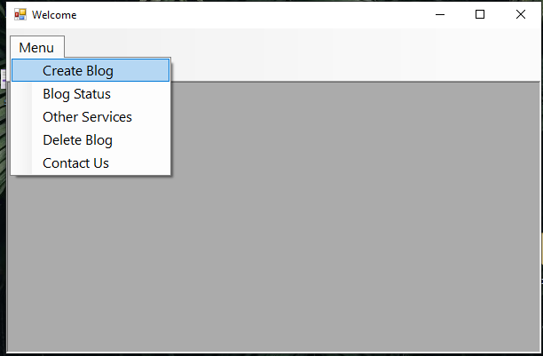
Output

Slide 13
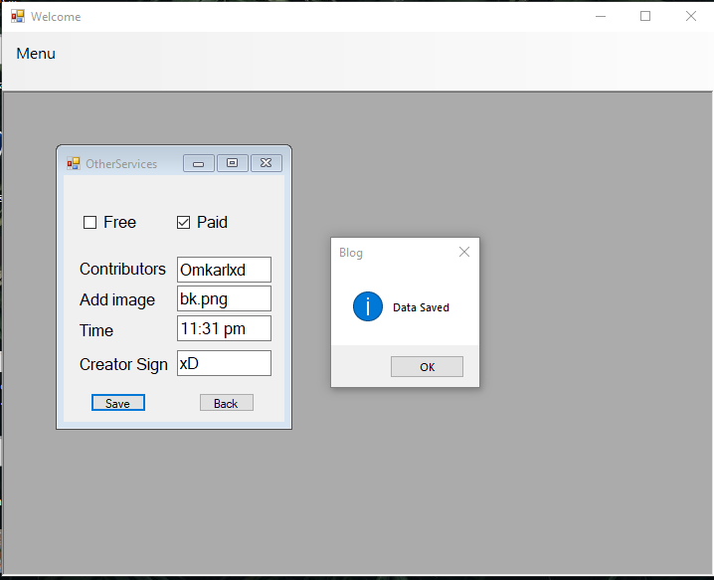
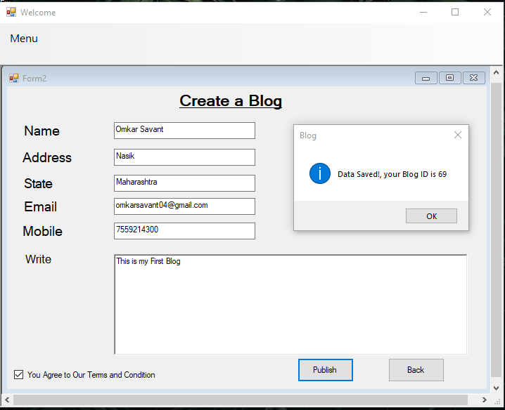
Output

Slide 14
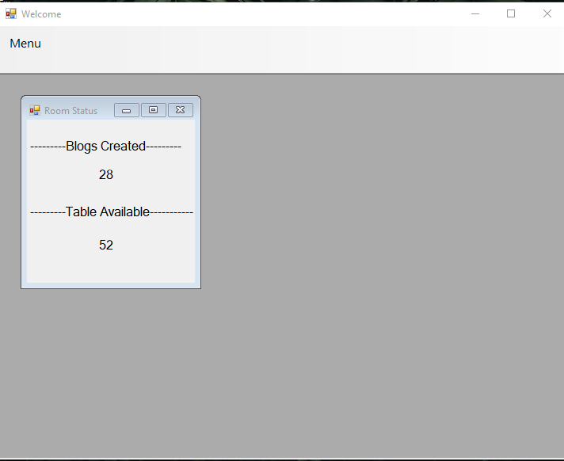
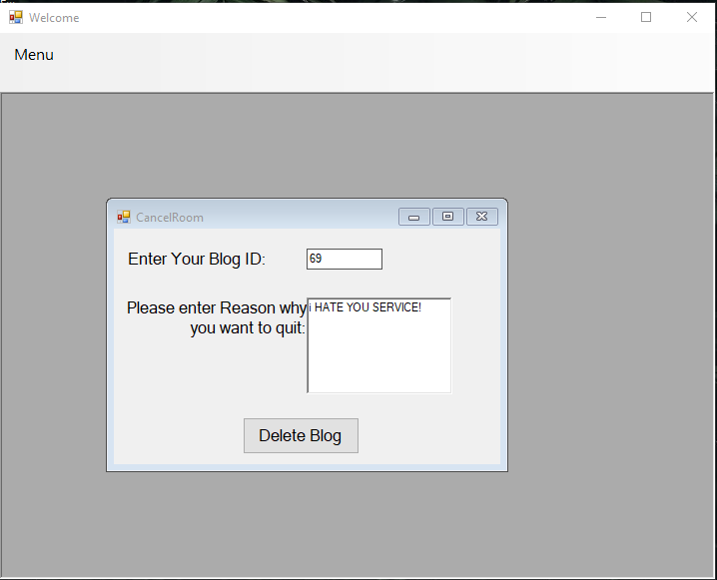
Output

Slide 15
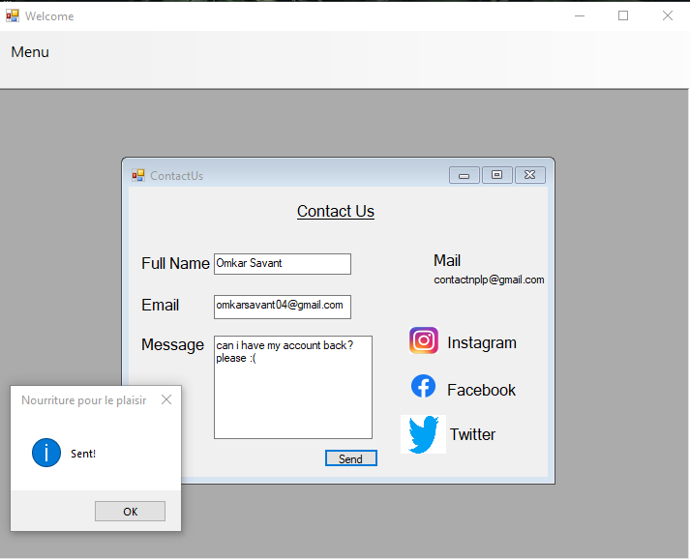
Output

Slide 16

Conclusion
Software, is a collection of instructions that tell a computer what to do.
Software Engineering includes development of software.
The Blog Management System effectively manages collection of different blogs uploaded on website.

Slide 17
Thank You

